Slide 1

SENTIMENTAL ANALYSIS IN PYTHON
MAJOR PROJECT- I REPORT
SUBMITTED BY:-
MOHD. SOHAIL ALI
2017-333-064
BTECH ECE
SUPERVISED BY:-
M/S SAMIA KHAN
PROFESSOR
SUBMITTED TO
Department of Computer Science & Engineering
School of Engineering Sciences & Technology
JAMIA HAMDARD
1

Slide 2
OBJECTIVE
The goal is to conceptually design and implement aspect-based sentiment analysis toolkit for extracting sentiment from the Twitter Data.

Slide 3
What is Sentiment Analysis?
Sentiment Analysis is a promising field of study because it helps to determine the opinions of sentences and documents, which is one of the first steps of understanding texts and inferring implied meanings of human communications.
It has commercial applications such as determining the acceptance and effectiveness of a product or service among the consumers etc.

Slide 4
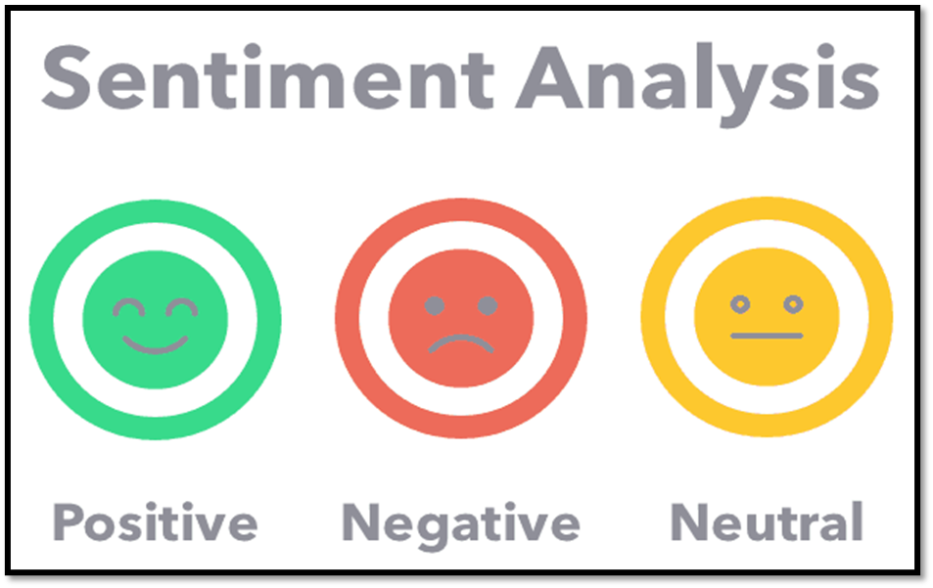
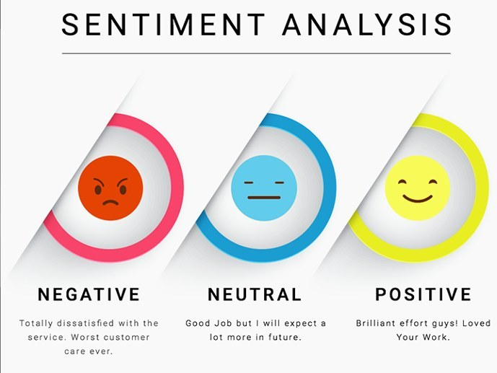

Slide 5
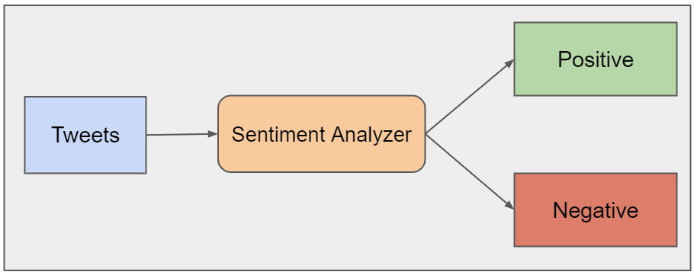
SYSTEM MODEL

Slide 6
HOW DOES THE ALGORITHM?
THE
SERVICE
WAS
TERRIBLE
BUT
THE
FOOD
WAS
GREAT
Positive
Words
Negative
Words

Slide 7
HOW DOES IT’S WORK?
+1 for good
0 for neutral
-1 for bad
Score
Positive
Words
Positive
Sample Statement
Neutral
Negative
Words
Negative

Slide 8
SYSTEM IMPLEMENTATION
Introduction
Implementation is the carrying out, execution, or practice of a plan, a method, or any design, idea, model, specification, standard or policy for doing something. As such, implementation is the action that must follow any preliminary thinking in order for something to actually happen.
Implementation is a process of ensuring that the information system is
●Constructing a new system from scratch
●Constructing a new system from the existing one.

Slide 9
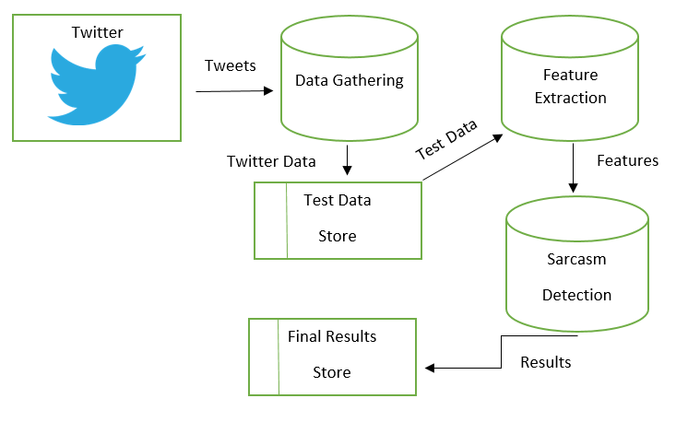
BLOCK DIAGRAM

Slide 10
SYSTEM IMPLEMENTATION
Modules
In software, a module is a part of a program. Programs are composed of one or more independently developed modules that are not combined until the program is linked. A single module can contain one or several routines.
Modules used in Project:
TWEEPY
PANDAS
NUMPY
MATPLOTLIB

Slide 11
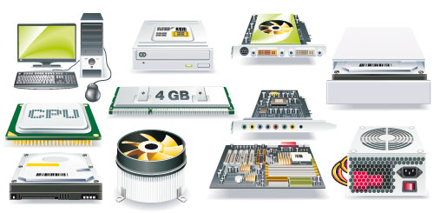
HARDWARE REQUIREMENTS
Processor: Intel i5 with clock speed of 2.4GHz or above.
RAM: 4GB or above.
Hard disk: 100GB or above.
Input device: Keyboard or mouse or compatible pointing devices.
Display: XGA (1024* 768px) or higher resolution monitor.

Slide 12



SOFTWARE REQUIREMENTS
Operating system : Windows 7 or above.
Programming Language : PYTHON 3
Development Environment : GOOGLE COLAB

Slide 13
What is GOOGLE Colaboratory?
Colaboratory, or 'Colab' for short, allows you to write and execute Python in your browser, with
Zero configuration required , Free access to GPUs , Easy sharing
Whether you're a student, a data scientist or an AI researcher, Colab can make your work easier.
13

Slide 14
WHAT IS PYTHON?
Overview:
Python is an interpreted, object-oriented, high-level programming language with dynamic semantics. Its high-level built in data structures, combined with dynamic typing and dynamic binding, make it very attractive for Rapid Application Development, as well as for use as a scripting or glue language to connect existing components together. Python's simple, easy to learn syntax emphasizes readability and therefore reduces the cost of program maintenance. Python supports modules and packages, which encourages program modularity and code reuse. The Python interpreter and the extensive standard library are available in source or binary form without charge for all major platforms, and can be freely distributed.

Slide 15
Features of Python
Easy to code: Python is a high-level programming language
Free and Open Source
Object-Oriented Language
GUI Programming Support
High-Level Language
Extensible feature
Python is Portable language
Python is Integrated language
Interpreted Language
Large Standard Library

Slide 16
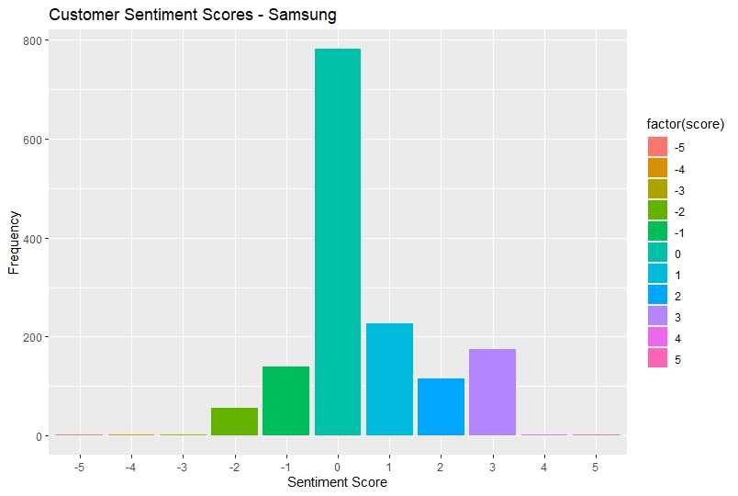
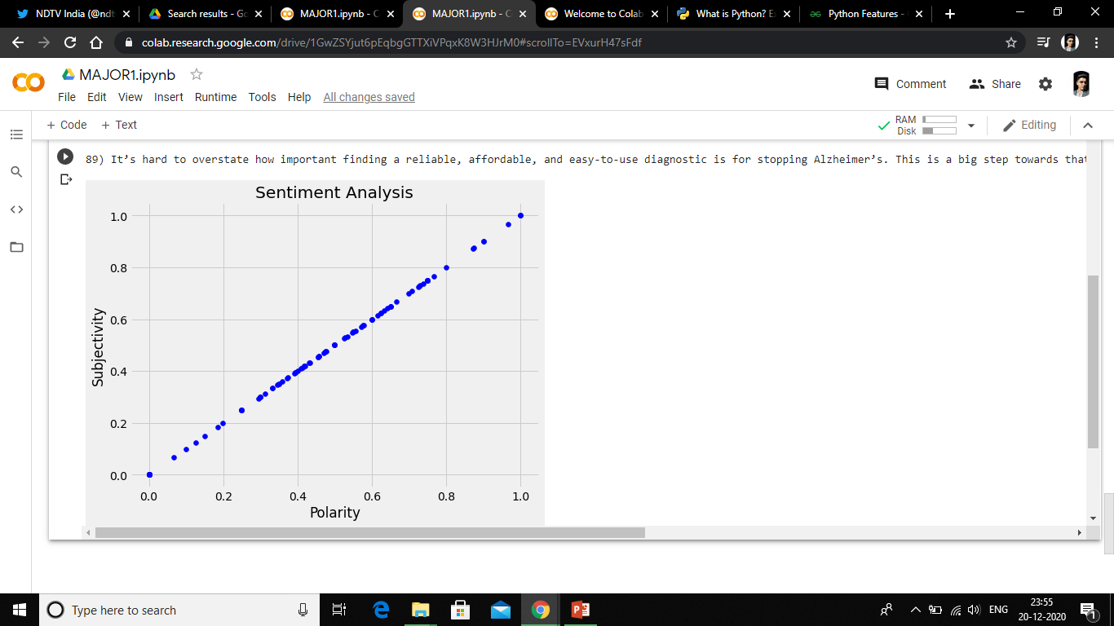

Slide 17
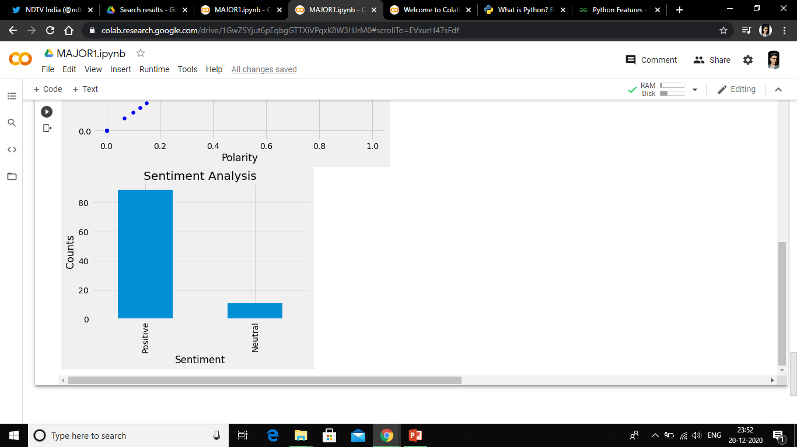
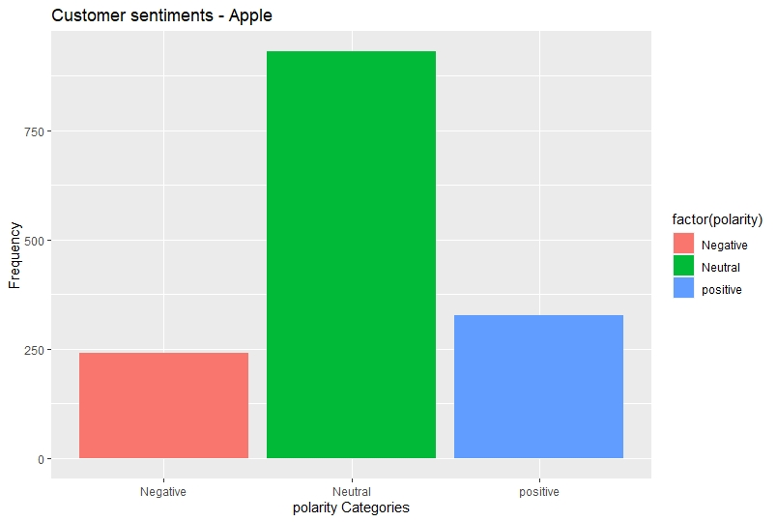
RESULT
Tweet 1:-

Slide 18
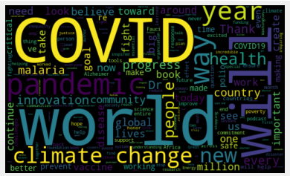
WORD CLOUD

Slide 19
CONCLUSION
In this project, As can be seen, sentiment analysis enables enterprises to understand consumer sentiments in relation to specific products/services. Moreover, these insights could be used to improve their products and services by gauging consumers’ comments and feedback using sentiment analysis. In the long run, sentiment analysis, if implemented the right way can aid business enterprises in improving the overall consumer experience, enhance brand image and propel business growth.

Slide 20
DRAWBACKS
Live sentiment analysis requires huge computational resource like memory resources to deal with vast extracted from the source (Twitter Extractor API).
Data quality must be maintained using filters such as metaphor filter, sarcasm filter to avoid noise in the collected data which increases the error percentage in the sentiment analysis.

Slide 21
Bibliography
[1] Efthymios Kouloumpis and Johanna Moore,IJCSI International Journal of Computer Science Issues, Vol. 9, Issue 4, No 3, July 2012
[2] S. Batra and D. Rao, ”Entity Based Sentiment Analysis on Twitter”, Stanford University,2010
[3] Saif M.Mohammad and Xiaodan zhu ,Sentiment Analysis on of social media texts:,2014
[4] Manju Venugopalan and Deepa Gupta ,Exploring Sentiment Analysis on Twitter Data, IEEE 2015
[5] Brett Duncan and Yanqing Zhang, Neural Networks for Sentiment Analysis on Twitter.2017

Slide 22
THANK YOU MOHD SOHAIL ALI

